Slide 1

BFA 2nd Year
Orientation 2021
Commences at 2:00 PM

Slide 2
Simon Cooper
Head of Studies
Lorraine Kypiotis
BFA Coordinator

Slide 3
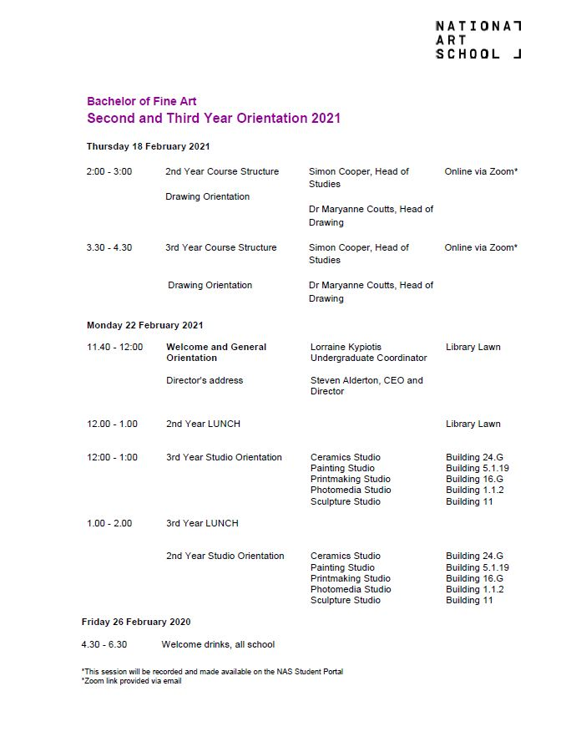

Slide 4
NAS 2021 Academic Calendar

Slide 6
BFA 2nd Year Course Structure

Slide 7
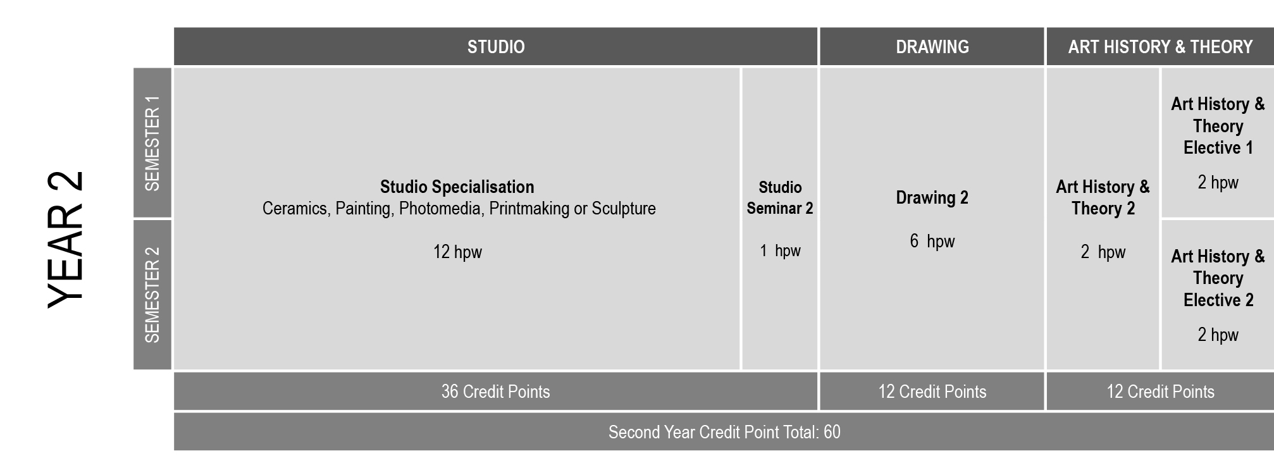
BFA 2nd Year Course Structure

Slide 8
BFA 2nd Year Course Structure
Art History & Theory
4 hrs p/week
Drawing
6 hrs p/week
Studio Specialisation
12 hrs p/week
Studio Seminar
1 hrs p/week

Slide 9
BFA 2nd Year Course Structure
Art History & Theory
4 hrs p/week total
Art History & Theory 2 core (AHT200)
  1 x 2 hrs p/week face-to-face seminar
  semester 1 & 2
AHT Elective/s
  1 x 2 hrs p/week face-to-face semester 1
  1 x 2 hrs p/week face-to-face semester 2

Slide 10
BFA 2nd Year Course Structure
Drawing
6 hrs p/week total
5 hrs p/week face-to-face
Semester 1 & 2
1 hr p/week Independent Study Component (ISC)
Semester 1 & 2

Slide 11
BFA 2nd Year Course Structure
Studio
Studio Specialisation
  12 hrs p/week face-to-face
  Semester 1 & 2
Studio Seminar
  1 hr p/week face-to-face
  Semester 1 & 2

Slide 12
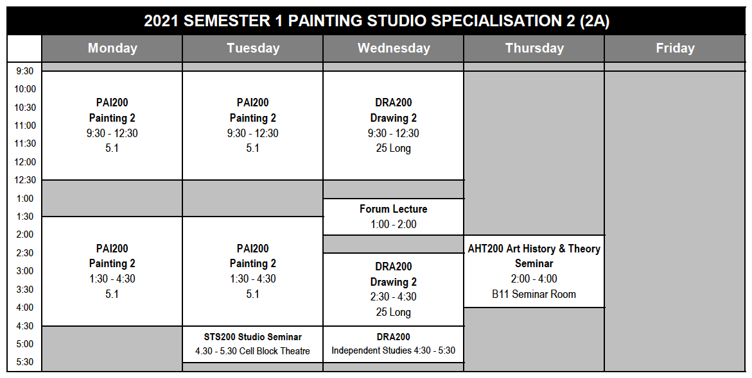
BFA 2nd Year Course Structure

Slide 13
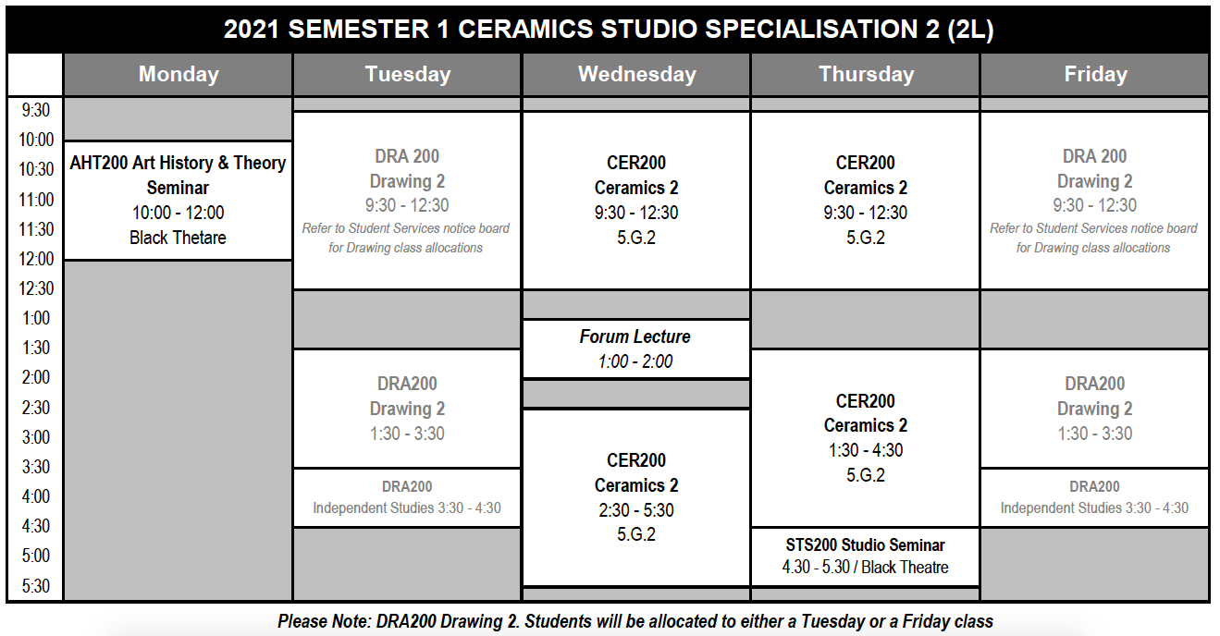
BFA 2nd Year Course Structure

Slide 14
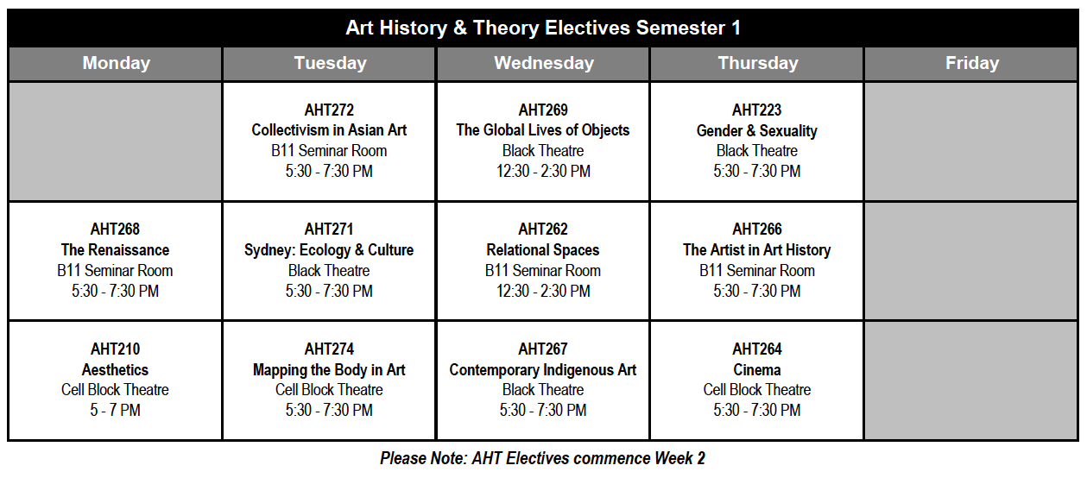
BFA 2nd Year Course Structure

Slide 15
Important Sources of Information
NAS Website / NAS Student Portal
Academic Calendar
NAS Student Handbook
Group Timetables
Subject Outlines and Resources
Links to online lectures / tutorials
Support Services for students
Student Opportunities

Slide 16
Important Sources of Information
NAS Student Handbook
Policies & Procedures
Course / Subject Outlines
Course rules
NAS Student Services Desk
Enrolment issues
Student Services

Slide 17
Important Contacts
BFA Coordinator
Course requirements and advice
Grievance procedures
Heads of Department / Lecturers
Subject specific requirements
Studio and course resources
NAS Registrar / Student Services
Enrolment and Fees
Student Support and enquries

Slide 18
NAS Policy & Procedure
Code of Conduct
Outlines the standards of conduct expected of students
Health & Safety
Academic Integrity
Standards of behaviour
Interactions with others
All staff and students at NAS should be treated with respect and courtesy
All staff and students have the right to feel safe

Slide 19
NAS Policy & Procedure
Attendance
All units of study at NAS include an attendance requirement of 80%.
This means that if you attend less than 80% of the specified contact time then you are at risk of failing to meet the required outcomes of the course.
If you have missed a class or classes
Speak to your relevant lecturers regarding any classes you have missed and what you may need to do to catch up.

Slide 20
Orientation Week
Monday 22 February
11:40 -12:00 Welcome
12:00 - 1:00 BBQ Lunch
1:00 - 2:00 Studio Orientations
Painting in B25 – all others as notified
Tuesday 23 – Friday 26 February
Drawing Week
Friday 26 February
4:30 - 6:30 PM Welcome Drinks

Slide 21
Enrolment Census Dates
The last day in which you can enrol in or withdraw from a subject.
Semester 1 only subjects
24 March 2021
Semester 1 & 2 (Full Year) Subjects
21 April 2021
Semester 2 only subjects
12 August 2021

Slide 22
NAS Student Email Address
All students issued with an @nas domain email address / Microsoft Office 365 account
Please activate your account
Your NAS Office 365 credentials can be utilised for accessing a range of NAS systems including:
NAS Student Portal
NAS Student Wifi
In 2021 NAS will be utilising @nas domain email address for all communications with students.

Slide 23
Covid Safety at NAS
Campus Protocols
QR Code Check-in (Service NSW app)
Maintenance of good hand and respiratory hygiene
Social Distancing
Staggered start times
Please do not attend NAS if you are experiencing cold or flu symptoms
Studio / Workshop Protocols
Covid Safety Guidelines
Available on NAS Student Portal

Slide 24
Room Capacities and Social Distancing at NAS
Current Government guidelines recommend limiting the capacity of indoor spaces to 1 person per 2 SQM
Government recommendations regarding physical distancing (1.5m) remain in place.
The capacity of all teaching spaces to meet this requirement has been assessed and is marked at the entrance to all rooms.
In the event that a class size exceeds a room’s capacity to accommodate physical distancing, the use of face masks is recommended.

Slide 25
Use of Facemasks at NAS
Under current government regulations, the wearing of a facemask is only compulsory in specific circumstances.
In situations where physical distancing may not be possible, the use of face masks is recommended.
Students should carry a clean face mask on them at all times and wear it in appropriate circumstances. Please note that NAS does not provide face masks to students - it is a responsibility of all students to provide their own face mask.

Slide 26
2nd Year Drawing Orientation
Dr Maryanne Coutts
Head of Drawing

Slide 27



SKIN DEEP
SKIN DEEP is an interactive exhibition and series of performances that presents intimate and personal stories of LGBTQI+ people through their tattooed bodies and stories, celebrating diversity, defiance and body art.
Powerhouse Director and Choreographer, Meryl Tankard, will work with community members and aerialist, The Amazing Ari, to present a beautiful performance of movement and dance that will slowly reveal the performer’s body tattoos, unveiling secrets and hidden stories. The Performance will be accompanied by arias of unrequited love by The Song Company.
18+
Please note body nudity will be included as part of the exhibition and performances
Cell Block Theatre
19, 20, 21, 26, 27, 28 February
7pm and 8pm Fridays and Saturdays; 5pm and 6pm Sundays
Tickets are FREE use code NASFAMILY
book @ nas.edu.au

Slide 28

Welcome to 2021
at National Art
School
Friday 26 February 4.30pm
Please join us at the NAS ArtBar & Kitchen for welcome drinks with your fellow students

