Slide 1



Academic Contingency Plan 2020
Semester 2 Arrangements
BFA 1

Slide 2

NAS Academic Contingency Plan
Background
Covid-19 Pandemic
Current Health advice
The Academic Contingency Plan is designed to deliver:
Course Content and total Volume of Learning for all courses
Maintenance of staff / student contact hours
Preservation of studio-based study in conjunction with theoretical enquiry

Slide 3
NAS Academic Contingency Plan
Key Features of Semester 2
Extended semester length / 33 week academic calendar
Return to face-to-face teaching
Revised timetables to accommodate:
  Increased course contact hours in studio practice components
  Management of social distancing expectations
Redistribution of 1st year groups (from 11 to 17) to reduce group sizes to maximum of 12 students.
Staggered class start and break times across all programs.

Slide 4
NAS Academic Contingency Plan
Semester 2 Overview
Semester 2 commencement: Monday 20 July
Semester 2 divided into 2 terms (Terms 3 and 4)
  Term 3: Mon 20 July – Fri 25 Sep (10 weeks)
  Mid semester break: Mon 28 Sep – Fri 9 Oct (2 weeks)
  Term 4: Mon 12 Oct – Fri 4 Dec (8 weeks*)
    *subject to stream/year level
    *includes assessment period

Slide 5
NAS Academic Contingency Plan
Semester 2 Overview
Final confirmation of Term 4 Arrangements
Final Term 4 arrangements to be confirmed mid term 3 in response to:
  confirmed student enrolments at census date (Aug 12)
  pandemic status / updated Health advice.

Slide 6
NAS Academic Contingency Plan
Semester 2 Overview
Teaching re-commences (face-to-face) from Semester 2 (week 16) commencing Monday 20 July:
Subjects re-commencing in Week 16
    Studio Introduction 1 (STU100)
    Drawing 1 (DRA100)
Subjects concluded in semester 1
    Art History & Theory 1 (AHT100)

Slide 7
NAS Academic Contingency Plan
Student Support
Student Services
Student Services desk operational
Academic English support delivered on campus
Student Counselling services delivered on campus
Library Open / No browsing till further notice
Student lounges/kitchens open
Café Open
After hours studio access as per normal arrangements

Slide 8
NAS Academic Contingency Plan
Academic Calendar
Academic Year extended by 3 weeks concluding December 5.
Revised Assessment dates
Enrolment Census dates extended.
  All subjects: Wednesday 12 August

Slide 9
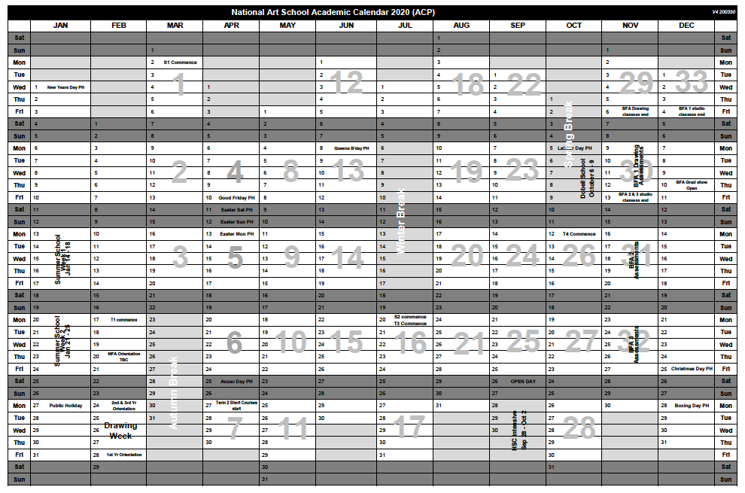
NAS Academic Contingency Plan
Academic Calendar

Slide 10
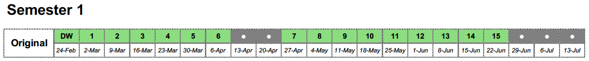
NAS Academic Contingency Plan
Academic Calendar

Slide 11
NAS Academic Contingency Plan
Academic Calendar

Slide 12
NAS Academic Contingency Plan
Academic Calendar

Slide 13
NAS Academic Contingency Plan
Academic Calendar

Slide 14
NAS Academic Contingency Plan
Bachelor of Fine Art / Year 1

Slide 15
NAS Academic Contingency Plan
BFA Year 1
Art History & Theory
All AHT100 course contact hours completed in Semester 1
No AHT100 classes in semester 2

Slide 16
NAS Academic Contingency Plan
BFA Year 1
Drawing (DRA100)
Remaining contact hours consolidated into Semester 2
Updated timetable
Increased to 12 Hours p/week (two days x 6 hrs)
Groups redistributed from 11 groups to 17 groups
Class size maximum of 12
DRA100 classes to conclude week 29 (week beginning 2 Nov)
Assessment in week 30 (week beginning 9 Nov)

Slide 17
NAS Academic Contingency Plan
BFA Year 1
Studio Introduction (STU100)
Remaining contact hours for each rotation consolidated into Term 3
30 Hrs per studio component (6 Hrs online/24 Hrs face-to-face)
Groups redistributed from 11 groups to 17 groups
Class size maximum of 12
Updated timetable and rotation schedule:
  Completion of initial rotations (weeks 1-3) in week 16/17
  3 week rotations of 8 hrs per day (24 Hrs total) from week 17 - 25
STU100 classes conclude week 25 / end of term 3)

Slide 18
NAS Academic Contingency Plan
BFA Year 1
Studio Electives (STU120)
Delivered in Term 4
2 x Studio Electives (72 Hrs each)
Weeks 26 – 33 (8 weeks)
Timetable tbc:
  3 x 6 hr days / 4 week rotations

Slide 19
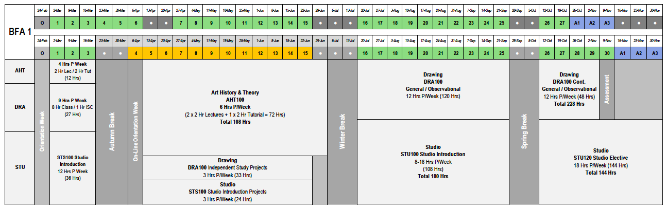
NAS Academic Contingency Plan
Course Schema / BFA 1

Slide 20
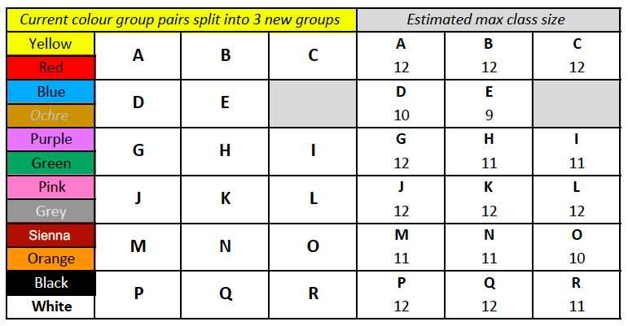
NAS Academic Contingency Plan
BFA Year 1
1st Year Studio Group Re-distribution

Slide 21
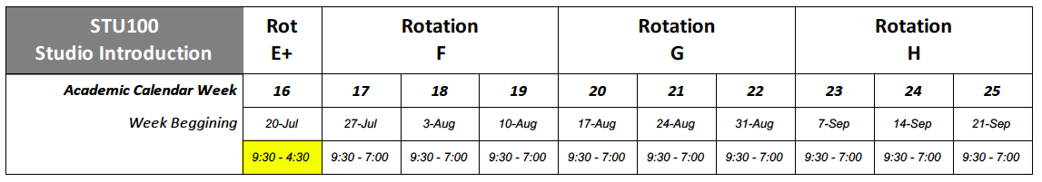
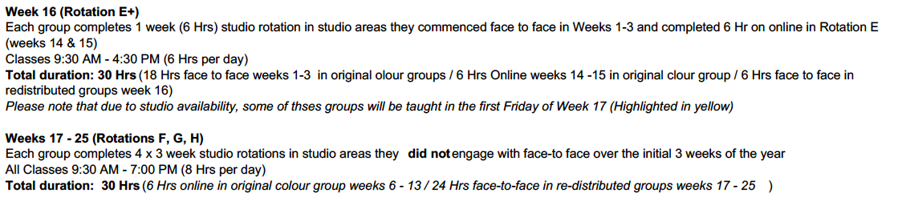
NAS Academic Contingency Plan
BFA Year 1
Studio Introduction Rotations in Term 3

Slide 23
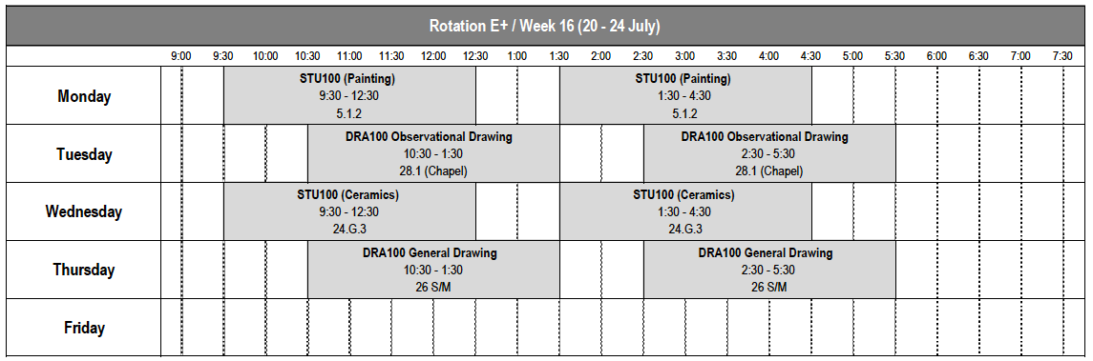
Example timetable

Slide 24
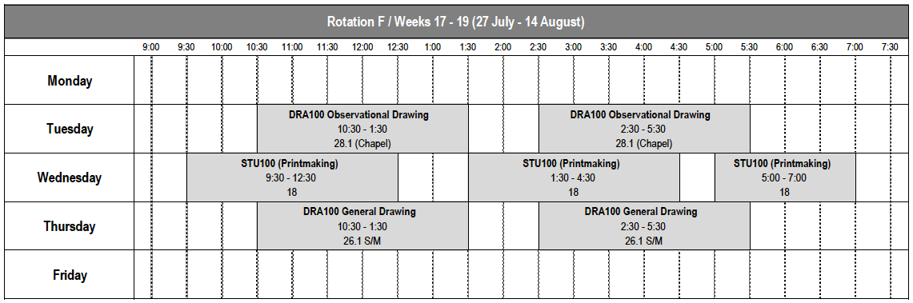
Example timetable

Slide 25

Example timetable

Slide 26
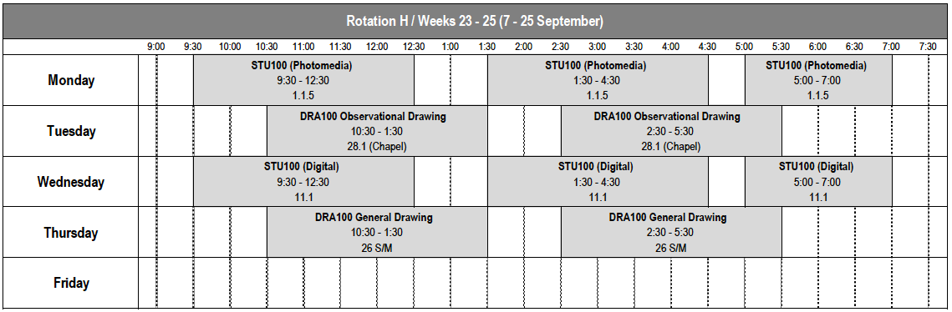
Example timetable

Slide 27
NAS Academic Contingency Plan
BFA 1
Attendance
Accurate recording of attendance is required to support contact tracing.
Application of Exceptional Circumstances
Emphasis upon ‘engagement’
Assessment based on achievement of learning outcomes as evidenced in work presented for assessment at the conclusion of each unit

Slide 28
NAS Academic Contingency Plan
Covid Safe protocols at NAS
Updated entry procedures including temperature checks
Revised building and room use
Sanitiser stations (fixed and mobile)
Covid Safety Officer
Revised studio/equipment protocols
Increased cleaning of high contact surfaces
Staggered start and finish times

Slide 29
NAS Academic Contingency Plan
What happens if we have a confirmed Covid case at NAS?
In the event that a staff member or student of NAS is confirmed as having contracted Covid-19 and has been on campus, NAS will consult with NSW Heath authorities and comply with directions.
This may result in a temporary shut down of NAS campus in order to accommodate contract tracing.

Slide 30
NAS Academic Contingency Plan
What happens if NAS campus is closed again?
Further contingencies have been developed in order to respond to any enforced closure of the campus. These include:
  Shortening of the mid semester break
  Further Extension of the Academic Year into early 2021 if required.

Slide 31
NAS Academic Contingency Plan
Further Information
NAS Website / Student Portal
Email
NAS Student Services:
Monday–Thursday 9am–5pm and Fridays 9am–3pm
02 9339 8651
student.services@nas.edu.au

